Slide 2
MONITORIA

Slide 3
NUMBERS

Slide 4
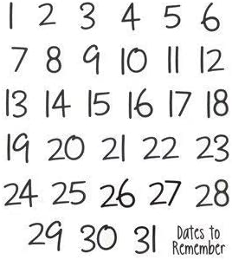

Slide 5
FAMILY

Slide 6
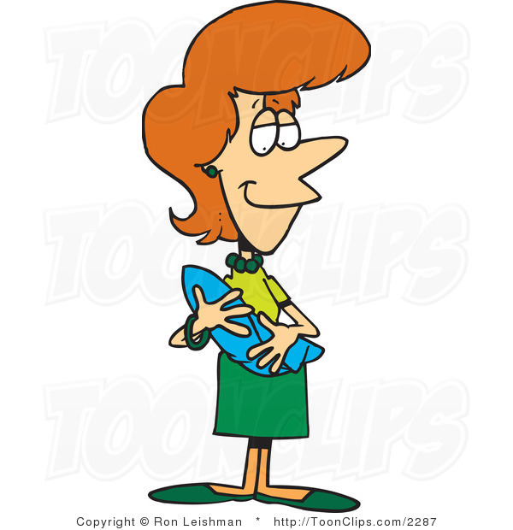
My Mother

Slide 7
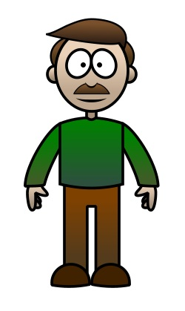
My Father

Slide 8

My Brother

Slide 9

My Sister

Slide 10

Me

Slide 11
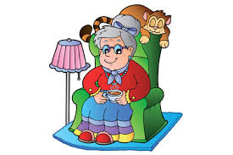
My Grandmother/Grandma

Slide 12
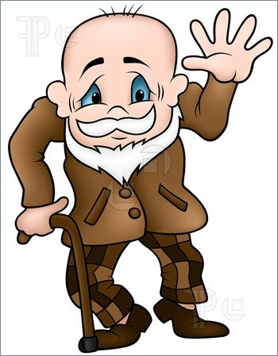
My Grandfather/Grandpa

Slide 13

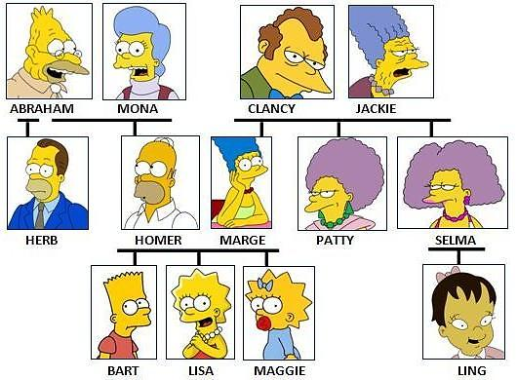
family tree

Slide 14
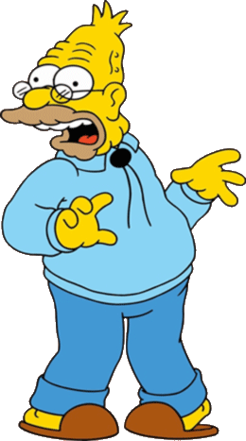
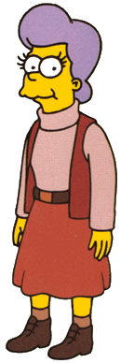
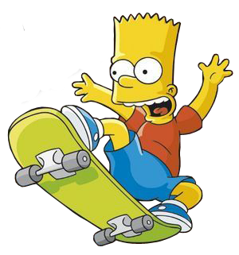
parents
grandparents
grandad
Abraham and Mona are Bart’s …

Slide 15
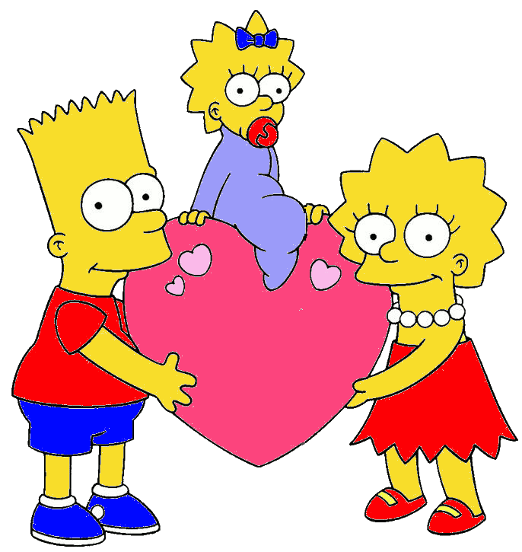
grandchildren
children
grandson
Bart, Lisa and Maggie
are Abrahan and Mona’s …

Slide 16
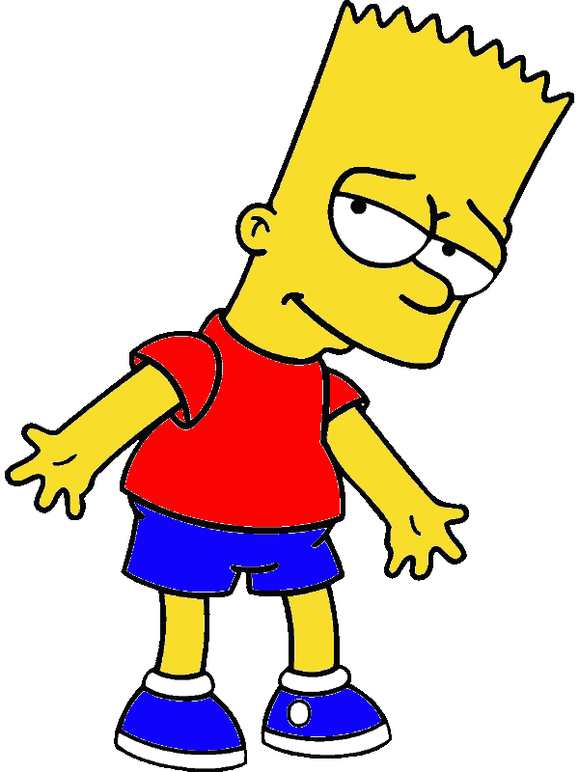
grandmother
grandfather
father
Abraham is Bart’s …

Slide 17
granddaughter
nephew
grandson
Bart is Abraham’s …

Slide 18
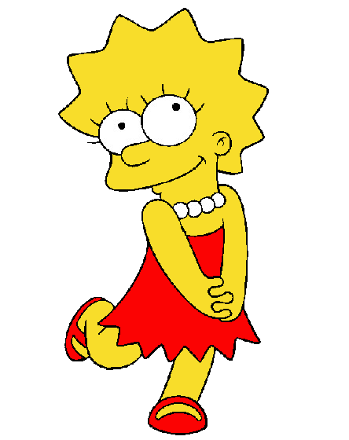
grandmother
mother
grandad
Mona is Lisa’s …

Slide 19
daughter
granddaughter
grandson
Lisa is Mona’s …

Slide 20
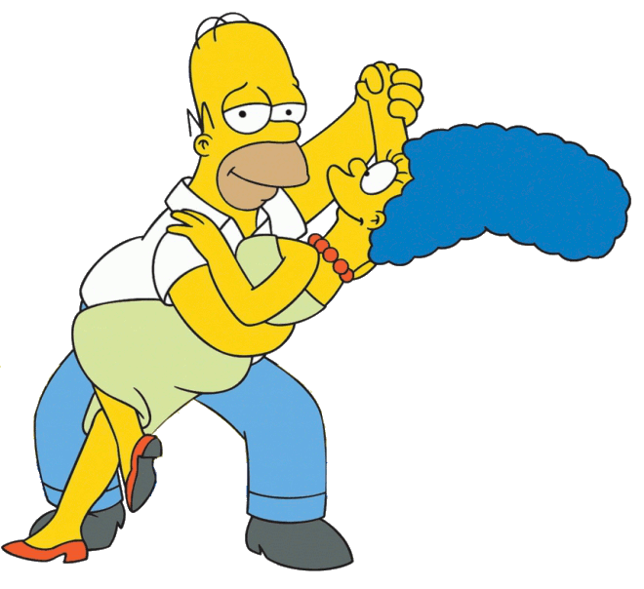
father
grandparents
parents
Homer and Marge are Lisa’s …

Slide 21
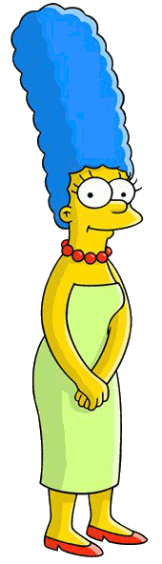
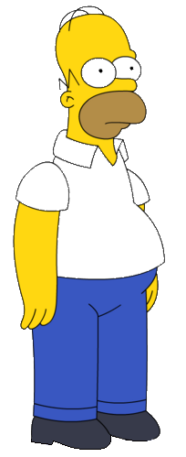
father
grandad
husband
Homer is Marge’s …

Slide 22
sister
wife
mother
Marge is Homer’s …

Slide 23
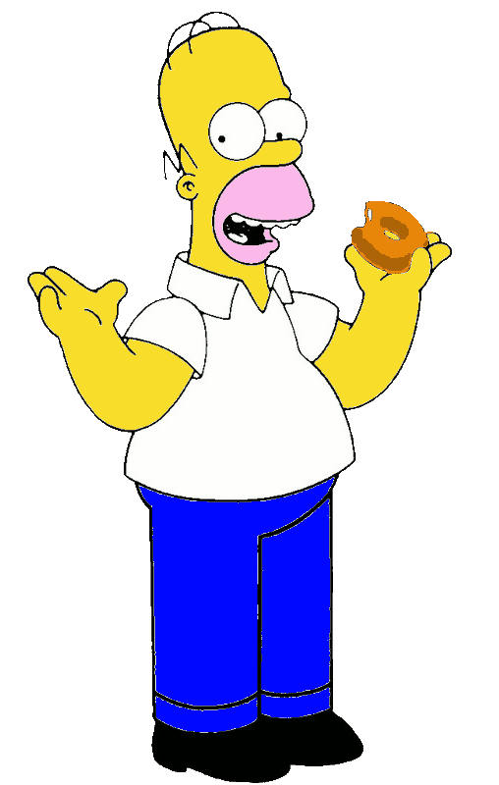
uncle
father
grandad
Homer is Lisa’s …

Slide 24
mother
aunt
grandmother
Marge is Lisa’s …

Slide 25
granddaughter
children
grandson
They are Homer and Marge’s …

Slide 26
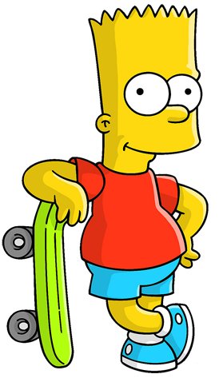
nephew
grandson
son
Bart is Homer and Marge’s …

Slide 27
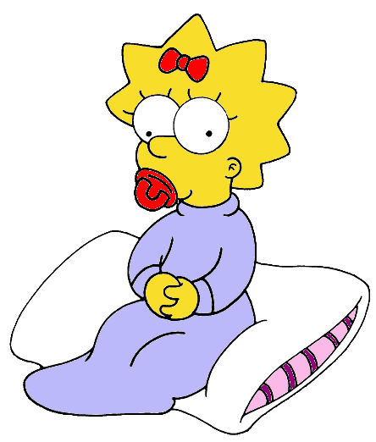
sisters
daughters
nieces
Lisa and Maggie are Homer and Marge’s …

Slide 28
nieces
sisters
cousins
Lisa and Maggie are Bart’s …

Slide 29
cousin
nephew
brother
Bart is Lisa and Maggie’s …

Slide 30
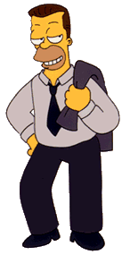
uncle
father
grandad
Herb is Lisa’s …

Slide 31
nephew
niece
daughter
Lisa is Herb’s …

Slide 32

cousin
niece
nephew
Burt is Herb’s …

Slide 33
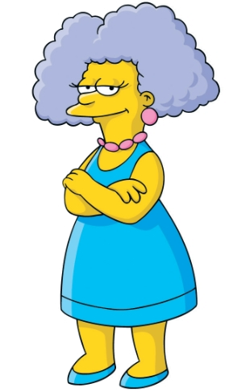
aunt
uncle
cousin
Selma is Lisa’s …

Slide 34

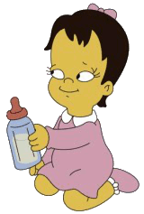
niece
cousin
sister
Ling is Lisa’s …

Slide 35
WHERE ARE YOU FROM?

Slide 36
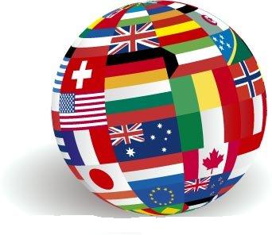
Where are they from?
What are their nationalities?

Slide 37
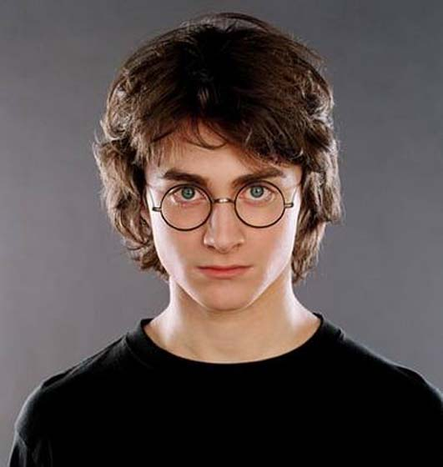

This is Daniel Radcliffe.
He is from England.
He is English.
ENGLAND

Slide 38
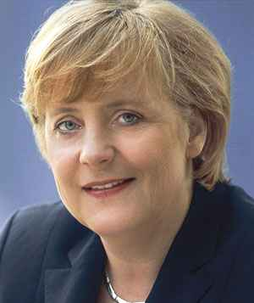

This is Angela Merkel.
She is from Germany.
She is German.

Slide 39
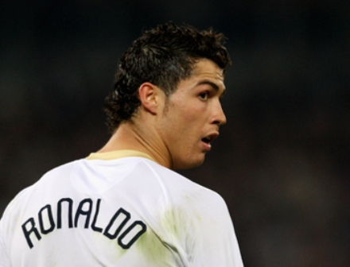

This is Cristiano Ronaldo.
He is from Portugal.
He is Portuguese.

Slide 40
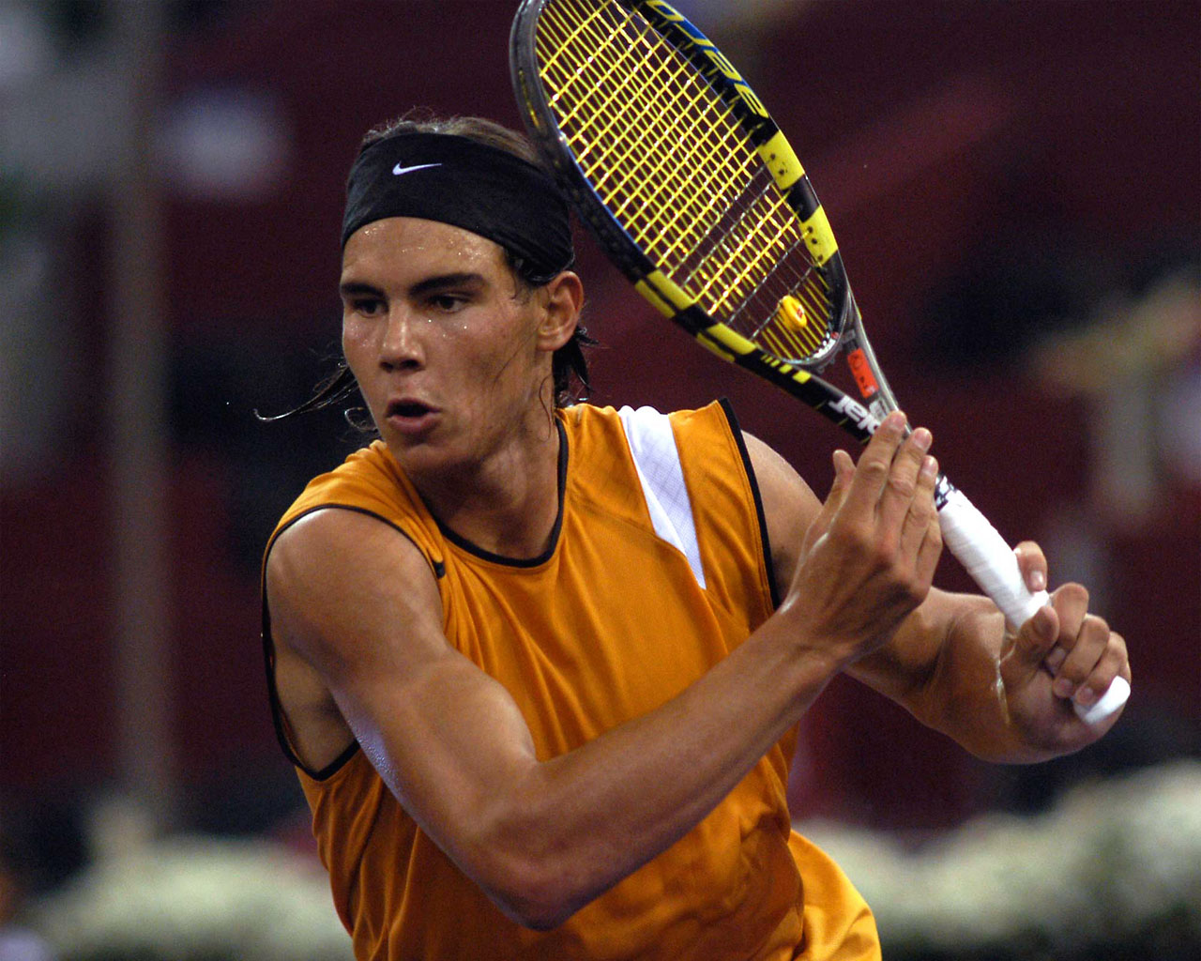
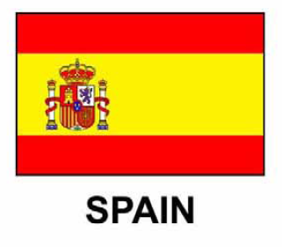
This is Rafael Nadal.
He is from Spain.
He is Spanish.

Slide 41

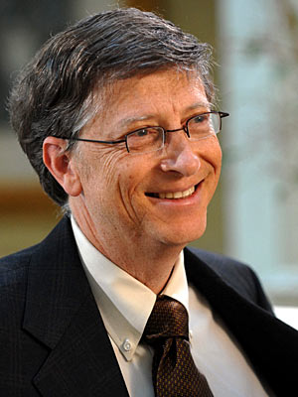
This is Bill Gates.
He is from the USA.
He is American.

Slide 42
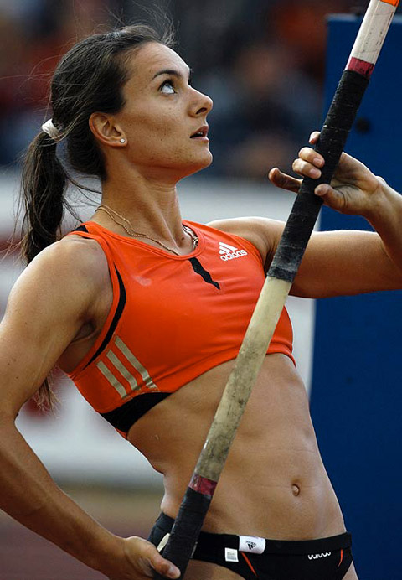

This is Yelena Isinbayeva.
She is from Russia.
She is Russian.
RUSSIA

Slide 43
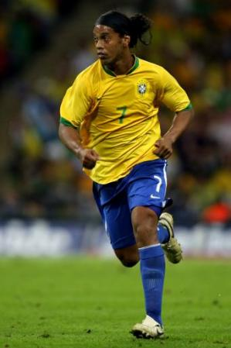

This is Ronaldinho.
He is from Brazil.
He is Brazilian.

Slide 44
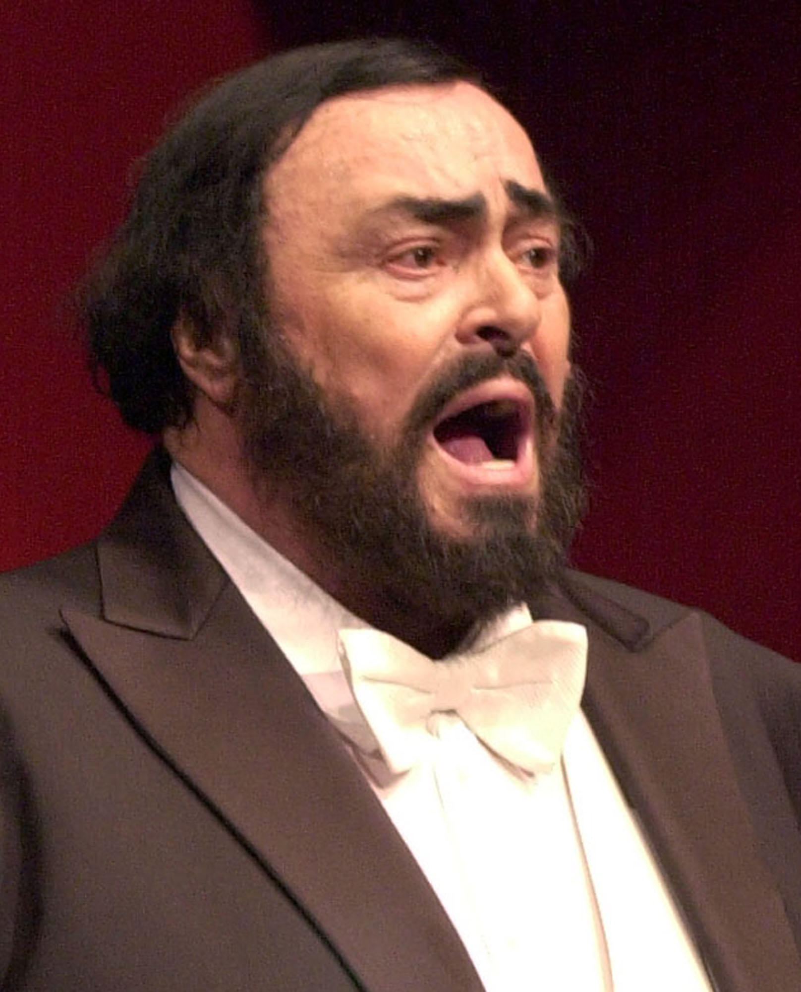
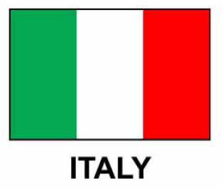
This is Luciano Pavarotti.
He is from Italy.
He is Italian.

Slide 45


Mary is from England.
She is English.
Mary
Yumiko
Anna
Nicole
Sarah

Slide 46
Mary is from ....................
She is ....................
Sarah is from ....................
Mary
She is ....................
Sarah
Lili is from ....................
She is ....................
Eleni is from ....................
Lili
She is ....................
Eleni

Slide 47
TELLING THE TIME

